Slide 1

PHP Session & Cookies

Slide 2
Objectives
Cookies in PHP
Session in PHP
POST/GET request parameters

Slide 3
Cookies
What is a Cookie?
A cookie is often used to identify a user. A cookie is a small file that the server embeds on the user's computer. Each time the same computer requests a page with a browser, it will send the cookie too. With PHP, you can both create and retrieve cookie values.
A cookie is created with the setcookie() function.
Only the name parameter is required. All other parameters are optional.
Syntax

Slide 4
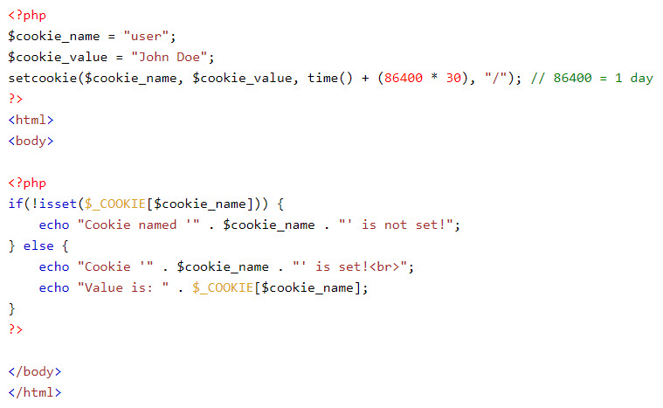
Cookies
Example

Slide 5
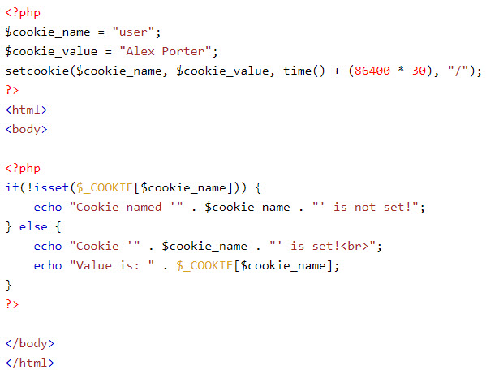
Cookies
To modify a cookie, just set (again) the cookie using the setcookie() function

Slide 6
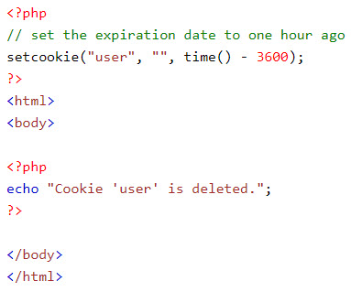
Cookies
To delete a cookie, use the setcookie() function with an expiration date in the past

Slide 7
Sessions
When you work with an application, you open it, do some changes, and then you close it. This is much like a Session. The computer knows who you are. It knows when you start the application and when you end. But on the internet there is one problem: the web server does not know who you are or what you do, because the HTTP address doesn't maintain state.
Session variables solve this problem by storing user information to be used across multiple pages (e.g. username, favorite color, etc). By default, session variables last until the user closes the browser.
Session variables hold information about one single user, and are available to all pages in one application.

Slide 8
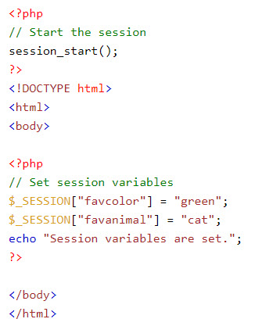
Sessions
A session is started with the session_start() function.
Session variables are set with the PHP global variable: $_SESSION.
Note: The session_start() function must be the very first thing in your document. Before any HTML tags.
Example

Slide 9
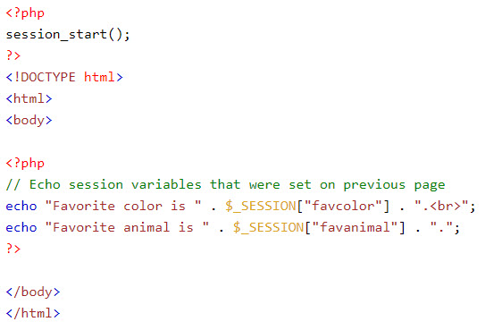
Sessions
All session variable values are stored in the global $_SESSION variable.
Example

Slide 10
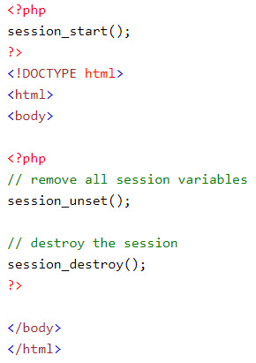
Sessions
To remove all global session variables and destroy the session, use session_unset() and session_destroy()
Example

Slide 11
Demo
Teacher demo session/cookie for students.

Slide 12
GET & POST Methods
There are two ways the browser client can send information to the web server.
The GET Method
The POST Method
Before the browser sends the information, it encodes it using a scheme called URL encoding. In this scheme, name/value pairs are joined with equal signs and different pairs are separated by the ampersand.

Slide 13
The GET Method
The GET method sends the encoded user information appended to the page request. The page and the encoded information are separated by the ?character.
The GET method produces a long string that appears in your server logs, in the browser's Location: box.
The GET method is restricted to send upto 1024 characters only.
Never use GET method if you have password or other sensitive information to be sent to the server.
GET can't be used to send binary data, like images or word documents, to the server.
The PHP provides $_GET associative array to access all the sent information using GET method.

Slide 14
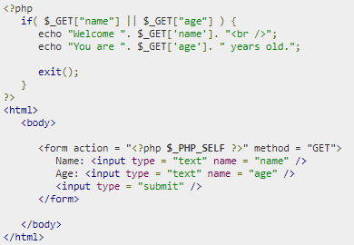
The GET Method
Example

Slide 15
The POST Method
The POST method transfers information via HTTP headers. The information is encoded as described in case of GET method and put into a header called QUERY_STRING.
The POST method does not have any restriction on data size to be sent.
The POST method can be used to send ASCII as well as binary data.
The data sent by POST method goes through HTTP header so security depends on HTTP protocol. By using Secure HTTP you can make sure that your information is secure.
The PHP provides $_POST associative array to access all the sent information using POST method.

Slide 16
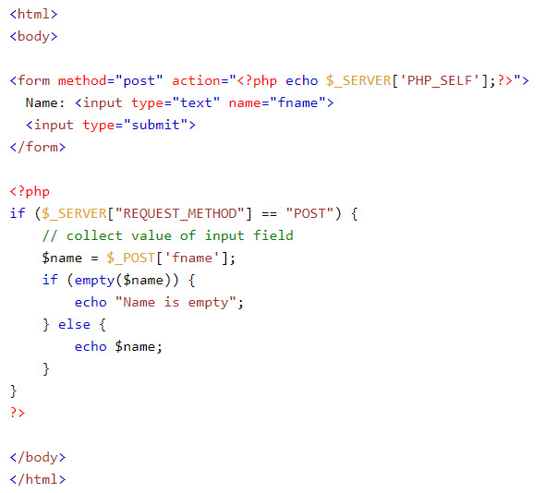
The POST Method
Example

Slide 17
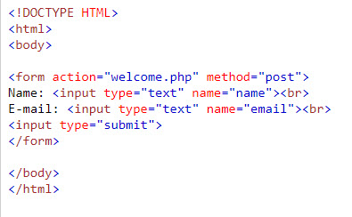
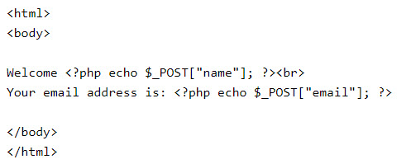


The POST Method
Example
Output:

Slide 18
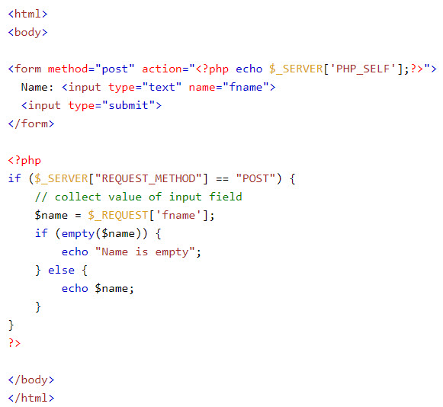
PHP $_REQUEST
PHP $_REQUEST is used to collect data after submitting an HTML form.
Example

Slide 19
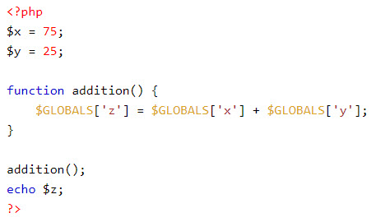
PHP $GLOBALS
$GLOBALS is a PHP super global variable which is used to access global variables from anywhere in the PHP script (also from within functions or methods).
PHP stores all global variables in an array called $GLOBALS[index]. The index holds the name of the variable.
Example

Slide 20
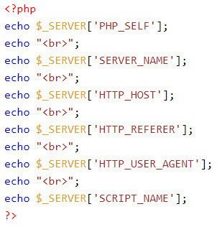
PHP $_SERVER
$_SERVER is a PHP super global variable which holds information about headers, paths, and script locations.
Example

Slide 21
Demo
Teacher demo POST/GET parameters for students

Slide 22
Summary
Cookies in PHP
Session in PHP
POST/GET request parameters

